Slide 1

Ratings Ontologies
Initial Stakeholder Meeting – February 6th 2019

Slide 2
Agenda
Note: This is not a full FIBO or Ontology introduction, please let us know if you would like one.
Introductions
What we are doing
How we are doing it
Introducing the draft rating ontology
Feedback and process
Next steps & Contacts

Slide 3
What we are doing
This initiative was initiated by Fannie-Mae, Fannie-Mae is developing an ontology based on FIBO.
That ontology will include financial ratings, data is purchase from industry sources and developed internally, the ontology can help integrate information as an “enterprise knowledge graph”
A FIBO process has been initiated to formalize ratings concepts in FIBO.
This process will include industry representatives
Everyone on this call is invited
What we will be asking of you
Determine if your are interested in participating
Provide feedback and input to the initial strawman
Engagement in creating & refining the ontologies
Use the ontology for products, services and integration

Slide 4
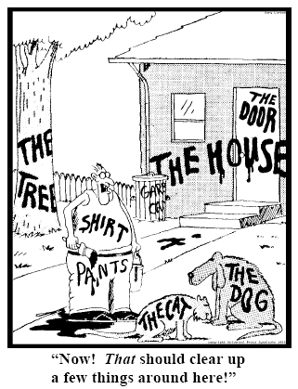

How we are doing it
FIBO – The “Financial Industry Business Ontology”, defines terms and meaning for the financial industry using an ontology language – “OWL” with UML diagrams
Ontologies define meaning in a precise and machine usable language

Slide 5



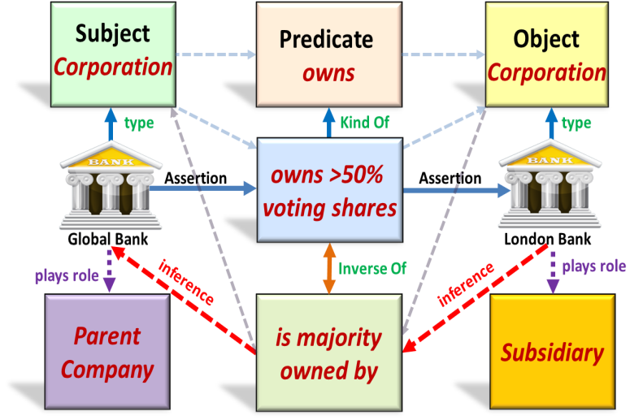


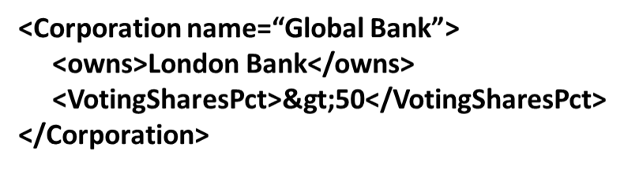


… that can Support Rosetta Stone Capabilities to Align and Harmonize Data via Common Meaning
Global Bank owns > 50% voting shares of London Bank
Semantic Mapping
FIBO Operational
Ontologies
FIBO Operational
Ontologies
RDBMS
FIBO
Ontologies
Semantic Adapters
Courtesy David Newman of Wells Fargo
Big Data

Slide 6

Benefits for Suppliers and Consumers
Easier for customers to consume suppliers data
More effective analytics; combining multiple ratings and other financial data
Standards based information sharing without custom schema
Semantic Web (RDF) data exchange and distributed query based on standard ontology

Slide 7
Strawman Taxonomy of Ratings Ontologies
FIBO
Today's Focus
Generic Ratings Concepts
Others
Ratings of Legal Entities
Ratings of Financial Instruments
Rating Categories
Others
Credit Ratings
Financial Strength
Performance Ratings

Slide 8
Essential Concepts
Standing of something at a particular time as indicated by one or more rating scores with respect to some scale according to some rating party
a party that performs a rating assessment to publish a rating. Frequently but not always the rating issuer.
Rating
Issued by
Rating Party
rates
Has rating score
Uses
grade, classification, or ranking of for something in accordance with some rating scale
Something
system for assigning a value to something according to some scale with respect to quality, a standard, or ranking.
Rating Score
Has definition
Rating Scale

Slide 9
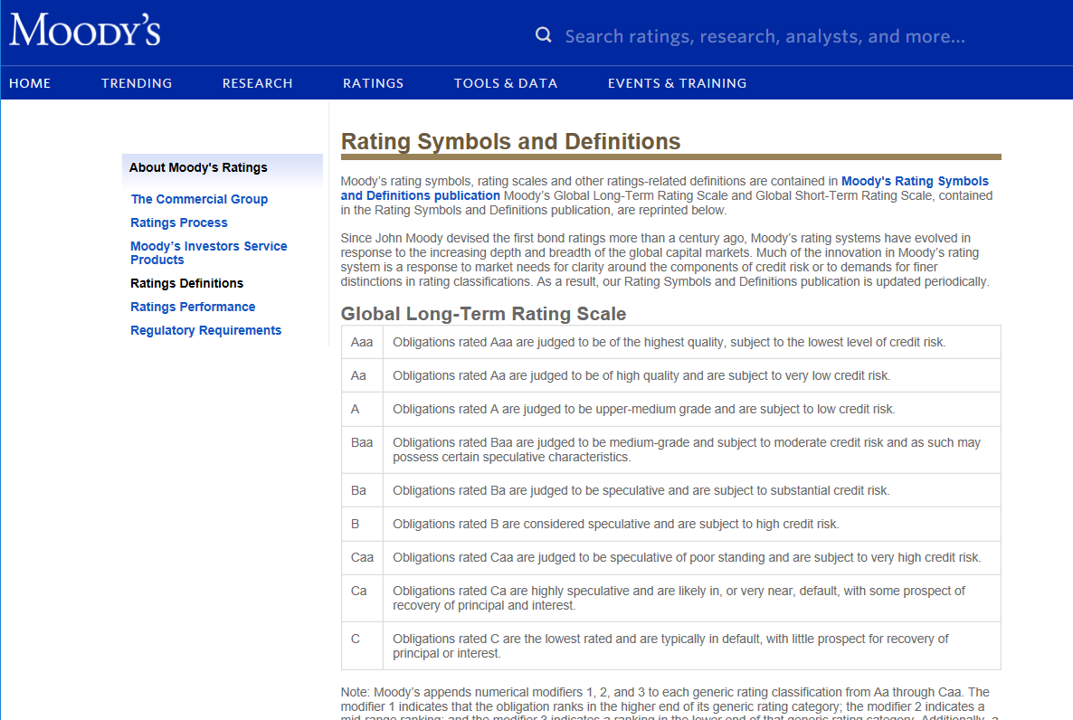
Example of scales and scores

Slide 10
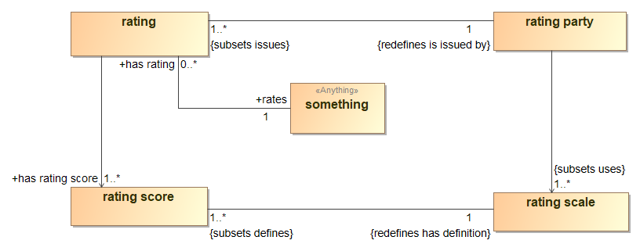
Essential Concepts – Ontology Diagram*
Reuse of general FIBO concepts
Reuse of general FIBO concepts
* UML Semantic Concept Modeling Profile

Slide 11
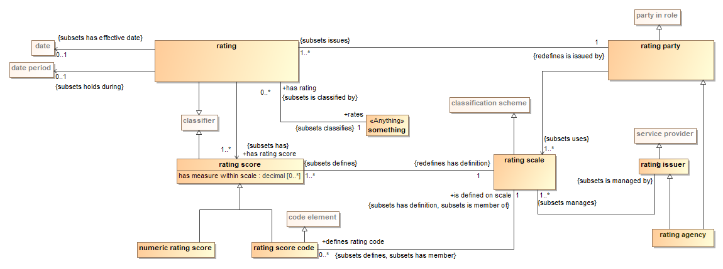
Completing Detail

Slide 12
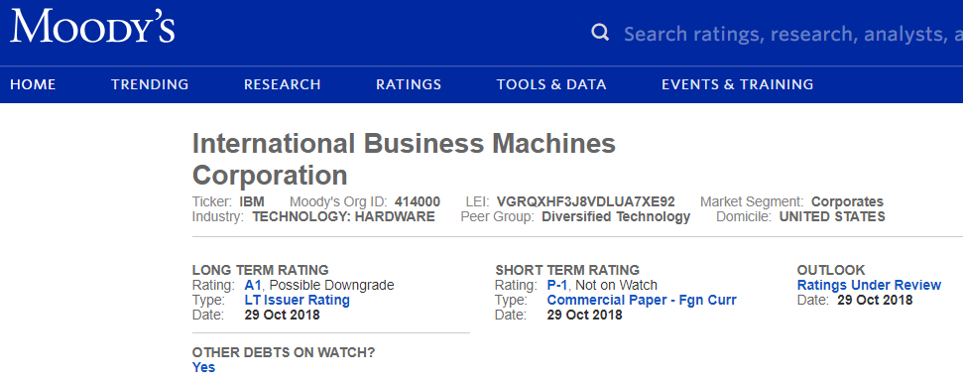
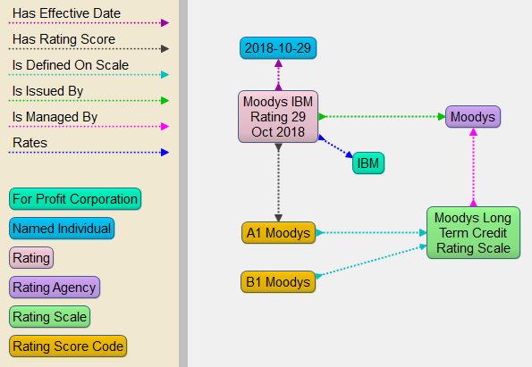
Example “fact”
Knowledge Graph

Slide 13
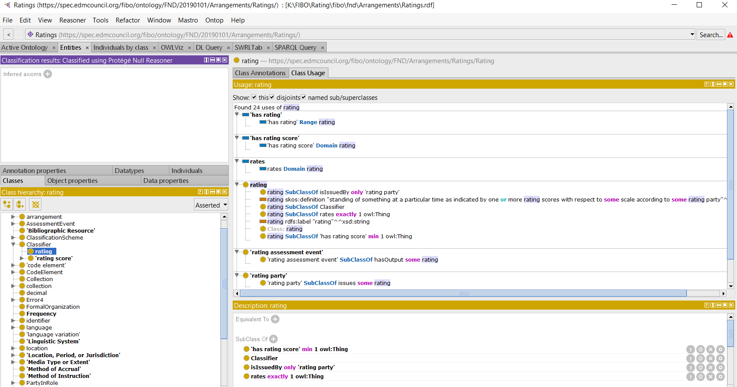
Rating concept in OWL ontology editor (Protégé)

Slide 14
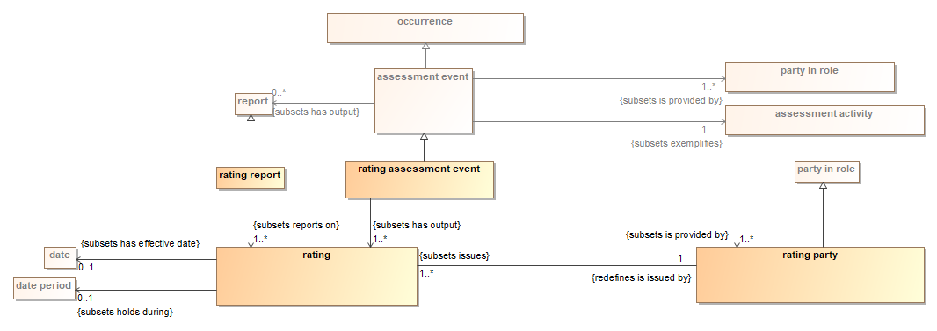
Assessments produce ratings

Slide 15
Definition of Concepts - Classes
Class | Definition
assessment activity | an evaluation or estimation of the nature, quality, or ability of someone or something
assessment event | event involving the evaluation or estimation of the nature, quality, or ability of someone or something
classification scheme | a system for allocating classifiers (elements in a classification scheme) to objects, similar to identifiers in some cases; such classification schemes are intended to permit the classification of arbitrary objects into hierarchies (or partial orders)
classifier | a standardized classification or delineation for something, per some scheme for such delineation, within a specified context
code element | a sequence of characters, capable of identifying that with which it is associated for some purpose, within a specified context, i.e., a code set, according to a pre-established set of rules
code set | A system of valid symbols that substitute for specified values, e.g., alpha, numeric, symbols and/or combinations
date | a calendar day on some calendar
formal organization | An Organization that is recognized in some legal jurisdiction, with associated rights and responsibilities. Examples include a Corporation, Charity, Government or Church.
numeric rating score | rating score that is a simple number on some scale, such as a credit rating for an individual
party in role | a relative concept that ties an independent party to a specific role they are standing in in which they play some part i.e. are party to
rating | standing of something at a particular time as indicated by one or more rating scores with respect to some scale according to some rating party
rating agency | rating issuer and party responsible for managing one or more rating schemes and publishing ratings based on those schemes
rating assessment event | individual assessment resulting in a grade or score and potentially a report describing the score
rating issuer | service provider responsible for managing one or more rating schemes and potentially publishing ratings based on those schemes
rating party | a party that performs a rating assessment to publish a rating. Frequently but not always the rating issuer.
rating report | a report describing a set of ratings.
rating scale | system for assigning a value to something according to some scale with respect to quality, a standard, or ranking
rating score | grade, classification, or ranking of for something in accordance with some rating scale
rating score code | rating score that is a qualitative code in some rating scale, such as a triple-A (i.e., AAA) or 5-star rating for something
rating service | service that assigns a value to something according to some rating scale
report | a document organized in a narrative, graphic, or tabular form, prepared on ad hoc, periodic, recurring, regular, or as required basis
service provider | a party that provides and typically provisions professional services, such as consulting, financial, legal, real estate, education, communications, storage, or processing services, to other parties, typically defined in a service agreement
something | anything

Slide 16
Definition of Concepts - Properties
Verb Phrase | Definition
classifies | arranges in classes; assigns to a category
defines | determines or identifies the essential qualities or meaning of, discovers and sets forth the meaning of, fixes or marks the limits of, demarcates
defines rating code | a rating score code defined within a rating scale
evaluates | indicates the nature, quality, or ability of someone or something being assessed
exemplifies | is a realization or example of
has definition | specifies a form of words that conveys the meaning associated with something
has effective date | the date a contract, relationship, or policy comes into force
has identity | provides a means for identifying something that fills a particular role
has measure within scale | indicates a relative, numeric measure or ordering on a rating scale
has member | relates something, typically a group or organization, to some discrete thing identified as a part (member) of it
has output | relates something (e.g. an occurrence) to something that is the result of some activity or process
has rating | indicates the rating assigned to a thing based on a grade or score according to a particular rating scale
has rating score | indicates the grade or score associated with a rating with respect to a particular rating scale
holds during | a relationship that states that some condition or state holds during a specified date period
is defined on scale | the scale on which a rating score code is defined
is exemplified by | identifies examples of a given concept
is issued by | indicates a functional entity or party responsible for circulating, distributing, or publishing something
is member of | belonging, either individually or collectively, to a group
is provided by | is made available by
issues | officially makes something available
managed by | relates something to another thing that has some role in directing its affairs
manages | relates an autonomous agent to something that it directs in some way
rates | indicates the instrument, party or something else to which a rating applies
reports on | indicates a subject matter, observation(s), assessment(s), focus or other topic of a report
uses | relates something to something else that it has the ability to employ in some way

Slide 17
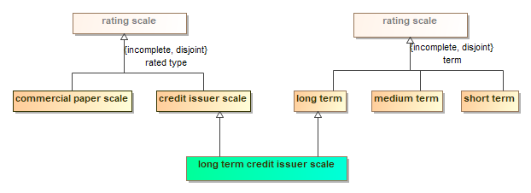
Example classification ontology: notional partitions
Classifications can be combined
What classifications are consistent across the industry?
Do we also need “soft” user defined classifications?

Slide 18
Engagement
Join mailing list and wiki: Contact Mike Atkin: atkin@edmcouncil.org
Contact Information:
Cory Casanave: cory-c@modeldriven.com (FIBO Ontologist Supporting Fannie-Mae)
Mike Atkin: atkin@edmcouncil.org (Managing Director, EDM Council)
Rodney Kagarise: rodney_b_kagarise@fanniemae.com (Data Model Mgr, Chief Data Office, Fannie-Mae)

Slide 19

Your Thoughts?

